Slide 1
Combinational Design

Slide 2
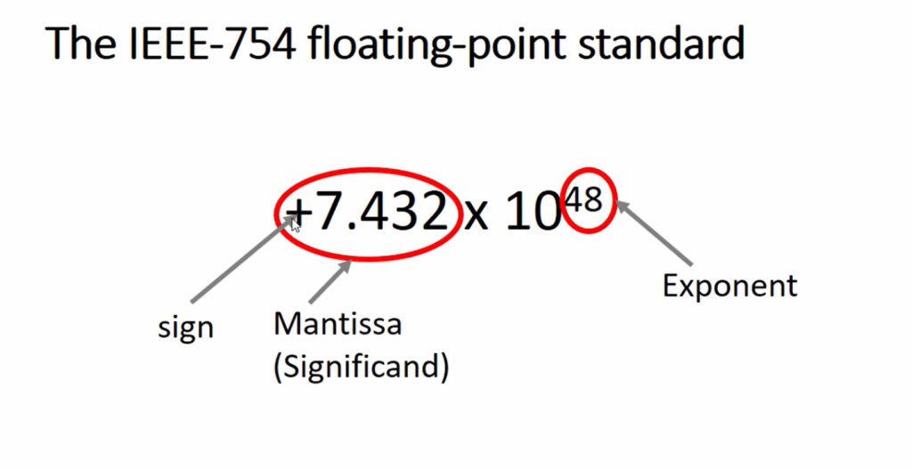
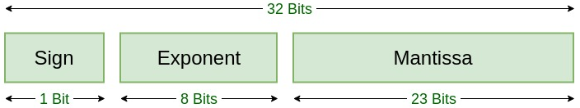
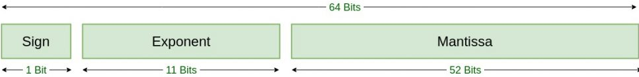
CONTENTS
Number system in digital design
  Number System: Binary
  1’s Complement
  2’s Complement
  Single Precision
  Double precision
Boolean Algebra in digital design
Optimization of Boolean expression using k-maps

Slide 3
Introduction
Logic circuits are the basis of modern digital computer systems.
To appreciate how computer systems operate, you will need to understand digital logic and boolean algebra.
  Boolean functions and truth tables
  Manipulation of boolean expressions
  Canonical forms
  Simplification of Boolean functions
Notes:
Canonical form means boolean functions expressed as a sum of minterms or product of maxterms (basically a suitable combination of the variables)

Slide 4
What does this have to do with computers, anyway?
One-to-one relationship between boolean functions and electronic circuits
For any boolean function, we can design an electronic circuit and vice versa

Slide 5
Number Systems and Codes
  Positional number systems
  Positional number system conversions
  Binary system operations
  Encoding techniques

Slide 6
Positional Number System
General form of a number:
d_{p-1}d_{p-2}…d_{0.}d₋₁d₋₂..d_{-n}
The value of the number:
Most significant digit (MSB)
Least significant digit (LSB)
Radix Point
Radix or Base
The radix or base of a number system specifies the actual number of digit included in its ordered set.
r-radix of the number system
d – digit in the set
p – number of digits in integer portion
n – number of digits in fractional portion
d_{p-1} – MSB
d_{-n} - LSB
Notes:
The radix or base of a number system specifies the actual number of digit included in its ordered set.
r-radix of the number system
d – digit in the set
p – number of digits in integer portion
n – number of digits in fractional portion
d_{p-1} – MSB
d_{-n} - LSB

Slide 7
Decimal System
d : 0, 1, 2, . . . , 9 r = 10
1453.05
p = 4 , n = 2
d₋₂
5x10⁻²
d₃
d₋₁
d₂
d₁
d₀
1x10³
0x10⁻¹
4x10²
5x10¹
3x10⁰
1x10³ + 4x10² + 5x10¹ + 3x10⁰ + 0x10⁻¹ + 5x10⁻² = 1453.05

Slide 8
Binary System
b : 0 , 1 r = 2
1101.01
p = 4 , n = 2
b₋₂
1x2⁻²
b₃
b₋₁
b₂
b₁
b₀
1x2³
0x2⁻¹
1x2²
0x2¹
1x2⁰
1x2³ + 1x2² + 0x2¹ + 1x2⁰ + 0x2⁻¹ + 1x2⁻² = 13.25

Slide 9
Exercise
Calculate the equivalent decimal numbers:
1₂
1x2⁰ = 1
10₂
1x2¹ + 0x2⁰ = 2 + 0 = 2
11₂
1x2¹ + 1x2⁰ = 2 + 1 = 3
100₂
1x2² + 0x2¹ + 0x2⁰ = 4 + 0 + 0 = 4
1011₂
1x2³ + 0x2² + 1x2¹ + 1x2⁰ = 8 + 0 + 2 + 1 = 11

Slide 10
Octal and Hexadecimal Numbers
Octal number System:
r = 8 d : 0, 1, 2, … , 7
Hexadecimal number System:
r = 16 d : 0, 1, 2, …, 9, A, B, C, D, E, F
Used for representations of long binary numbers

Slide 11
Binary, Decimal, Octal and Hex #s
Decimal Binary Octal Hexadecimal
0 0000 00 0
1 0001 01 1
2 0010 02 2
3 0011 03 3
4 0100 04 4
5 0101 05 5
6 0110 06 6
7 0111 07 7
8 1000 10 8
9 1001 11 9
10 1010 12 A
11 1011 13 B
12 1100 14 C
13 1101 15 D
14 1110 16 E
15 1111 17 F

Slide 12
Binary – Octal Conversion
Starting from the decimal point:
Separate the bits into groups of three
Replace each group with its corresponding Octal digit
100011110 . 10101₂ =
100 011 110 . 101 010₂ =
436 . 52₈
Notes:
Quite frequently, conversions from one base system to another must be made.

Slide 13
Binary - Hexadecimal Conversion
Starting from the decimal point:
Separate the bits into groups of four
Replace each group with its corresponding Hexadecimal digit
100011110 . 10101₂ =
0001 0001 1110 . 1010 1000₂ =
11E . A8₁₆

Slide 14
Octal - Binary Conversion
Convert each Octal digit into its corresponding three bit string
436 . 52₈ =
100 011 110 . 101 010₂

Slide 15
Hexadecimal - Binary Conversion
Convert each Hexadecimal digit into its corresponding four bit string
A5E . C8₁₆ =
1010 0101 1110 . 1100 1000₂

Slide 16
Radix-r to Decimal Conversion
Notes:
Ex: (223)₄ to decimal

Slide 17
Decimal to Radix-r Conversion
Successive division of D by r
The remainder of the long division will give the digits starting from the least significant digit

Slide 18
Decimal to Binary Conversion
45₁₀
45/2 = 22 The remainder is 1 LSB
22/2 = 11 0
11/2 = 5 1
5/2 = 2 1
2/2 = 1 0
1/2 = 0 1 MSB
MSB LSB
32 16 8 4 2 1
1 0 1 1 0 1
Notes:
Convert 23 to binary
Convert 0.47 to binary

Slide 19
Decimal to Binary Conversion
0.52₁₀ = (?)₂
Notes:
Convert 23 to binary
Convert 0.47 to binary

Slide 20
Demonstrate base 12, base 20, custom base
3A + AD (radix 6)
Notes:
custom base – 0, 3, 5, X, A, D
Cryptography
Error Detection and Correction
Unique Symbols
Reduced Symbol Set

Slide 21
Exercises
Convert 5 into binary:
1 0 1
hexadecimal:
5
Convert 17 into binary:
1 0 0 0 1
hexadecimal:
11
Convert 34 into binary:
1 0 0 0 1 0
hexadecimal:
22

Slide 22
Binary Addition
Binary addition table:
carry in X Y X+Y carry out
0 0 0 0 0
0 0 1 1 0
0 1 0 1 0
0 1 1 0 1
1 0 0 1 0
1 0 1 0 1
1 1 0 0 1
1 1 1 1 1

Slide 23
Example:
16 8 4 2 1
1 0 1 0 1
0 1 1 0 0
21
12
33
1 0 0 0 0 1

Slide 24
Binary Subtraction
Binary subtraction table:
X Y borrow in X-Y borrow out
0 0 0 0 0
0 0 1 1 1
0 1 0 1 1
0 1 1 0 1
1 0 0 1 0
1 0 1 0 0
1 1 0 0 0
1 1 1 1 1

Slide 25
Example:
16 8 4 2 1
1 1 0 1 0
0 1 1 1 1
26
15
11
0 1 0 1 1

Slide 26
Representation of Negative Numbers in Binary Systems
Signed-magnitude Representation
One’s-Complement Representation
Two’s-Complement Representation
Biased representation

Slide 27
Signed Magnitude Representation
The MSB represents the sign bit (0 = positive, 1 = negative)
The range for n-bit is from - 2^{n-1} – 1 to +2^{n-1} – 1.
Example: n=5, Range from -15 to 15
  00000 = 0 , 10000 = -0
  10011 = -3 , 01100 = +12
Disadvantages:
  Complicated digital adders
  Two possible representations of zero
Notes:
Ex: Complicated digital adders – 10+15 = 01010 + 01111 = 10001 (Answer is wrong)

Slide 28
Signed Magnitude Representation
Addition & Subtraction Operation
Add if signs are same
Sub if signs are different
Ex: 1000_0111 + 0111_0000

Slide 29
One’s Complement Representation
The MSB represents the sign bit (0 = positive, 1 = negative)
To calculate the negative number, complement all bits of the positive number
The range for n-bit is: from -2^{n-1} – 1 to +2^{n-1} – 1.
Advantages: Symmetry, ease of complementation.
Disadvantages:
  Two possible representations of zero.
  Complicated digital adders. (Ex: 7+7)
Notes:
Mathematics behind: ~u = 2³ – 1 - |u|
u = 101, |u| = 5, ~u = 010 => 8-1-5 = 2
Addition and Subtraction is challenging: 0010 + 1101

Slide 30
One’s-Complement Example
N = 8: form -127(10000000) to 127 (01111111)
+100₁₀ = 0 1 1 0 0 1 0 0
-100₁₀ = 1 0 0 1 1 0 1 1
0₁₀ = 0 0 0 0 0 0 0 0
-0₁₀ = 1 1 1 1 1 1 1 1

Slide 31
Two’s Complement Representation
The MSB represents the sign bit (0 = positive, 1 = negative)
To calculate the negative number:
  Complement all bits of the positive number
  Add 1
The range for n-bit is: from -2^{n-1} to +2^{n-1} – 1.
Advantages: Addition/subtraction performed directly and only one zero
Disadvantage: One extra negative number (not symmetric)

Slide 32
Two’s Complement Example
N = 8: from -128(10000000) to 127 (01111111)
0₁₀ = 0 0 0 0 0 0 0 0
1 1 1 1 1 1 1 1 step 1
+ 1 step 2
1 0 0 0 0 0 0 0 0 = 0₁₀
0 0 0 0 0 0 0 0 = 0₁₀

Slide 33
Two’s Complement Example
64 32 16 8 4 2 1
+100₁₀ =
0 1 1 0 0 1 0 0
step 1
1 0 0 1 1 0 1 1
step 2
+ 1
1 0 0 1 1 1 0 0 = -100₁₀

Slide 34
Comparison (4-bit)
Decimal Signed One’s Two’s
Magnitude Compl. Compl.
-8 - - 1000
-7 1111 1000 1001
-6 1110 1001 1010
-5 1101 1010 1011
-4 1100 1011 1100
-3 1011 1100 1101
-2 1010 1101 1110
-1 1001 1110 1111
0 0000 or 1000 0000 or 1111 0000
1 0001 0001 0001
2 0010 0010 0010
3 0011 0011 0011
4 0100 0100 0100
5 0101 0101 0101
6 0110 0110 0110
7 0111 0111 0111

Slide 35
Exercise
What is the representation of +11, -11 in:
5-bit signed magnitude representation
+11 =
0 1 0 1 1
-11 =
1 1 0 1 1
5-bit one’s complement representation
+11 =
0 1 0 1 1
-11 =
1 0 1 0 0
5-bit two’s complement representation
+11 =
0 1 0 1 1
-11 =
1 0 1 0 1

Slide 36
Number Circle
Demonstrate overflow, underflow, discontinuity
Reference: https://thesis.laszlokorte.de/demo/number-circle.html
Notes:
Add 13 and 5 – Crossing the breakpoint in clockwise direction causes overflow condition
Crossing the breakpoint in anti-clockwise direction causes underflow condition
Overflow – 7 + 7
Underflow – 7 – (-8)

Slide 37
Two’s Complement Addition (A+B)
Use binary addition rules
Ignore any carry beyond the sign bit
  If the range is not exceeded, addition result will be correct including the sign bit.
Examples:
(-2) 1 1 1 0
+ (-4) 1 1 0 0
(-3) 1 1 0 1
+ (+3) 0 0 1 1
(-6) 1 1 0 1 0
(0) 1 0 0 0 0

Slide 38
Two’s Complement Subtraction Method : (A+(-B))
Add A to the Two’s complement of B:
Take the One’s complement of B
Add it to A with initial carry-in i.e. 1
Example: 2-4
Initial Carry in
1
0 0 1 0
+ 1 0 1 1
2
One’s Complement of 4
(-2) 1 1 1 0
Two’s Complement Multiplication Method : (A*(-B))

Slide 39
Biased representation
Add the bias value to the number and convert it into binary
Ex: for 8-bit, bias value is 127
  1₁₀ = 1000_0000₂
  128₁₀ = 1111_1111₂
  -127₁₀ = 0000_0000₂
For addition of 2 numbers, add the operands and subtract the bias
Notes:
For addition of 2 numbers, add the operands and subtract the bias – because both number will be added with 127

Slide 40
Fixed Point Numbers
No. of bits = 16
No decimal point
  Range is -32768 to 32767 (or 0 to 65536)
Decimal point after 3 bits
  Range is -4096 to 4095 (or 0 to 8192) and 3 bits for fraction
Decimal point after 8 bits
  Range is -256 to 255 (or 0 to 512) and 7 bits for fraction
Limited precision and range – not sufficient to represent say weight of the earth = 5.972 × 10²⁴ kg , electron mass = 9.1093837015 × 10⁻³¹ kg

Slide 41
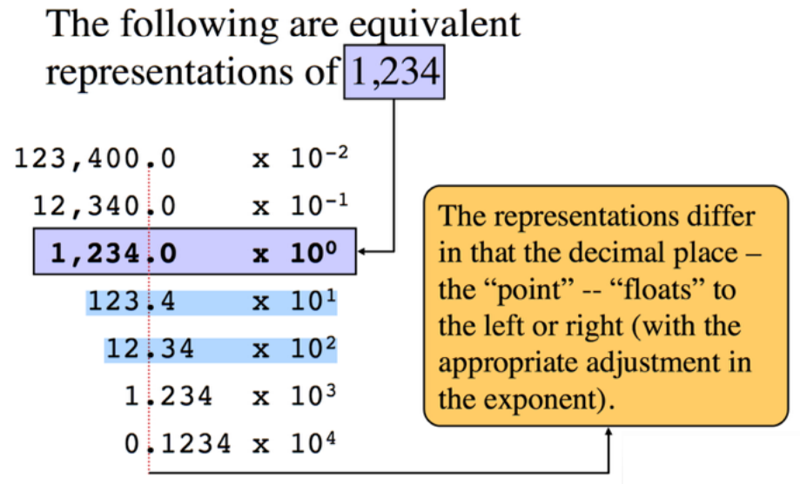
Floating Point Numbers

Slide 42
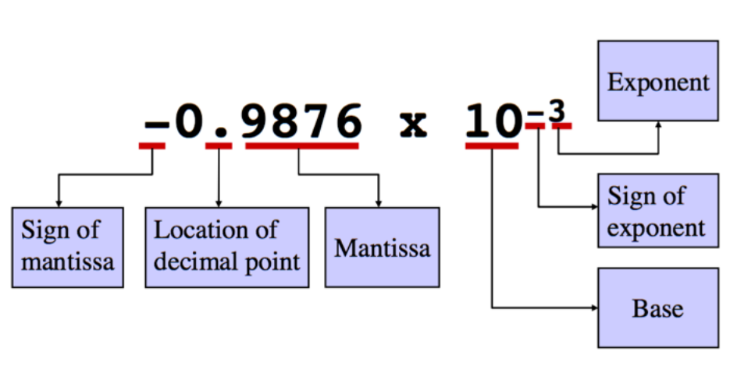
Floating Point Numbers

Slide 43
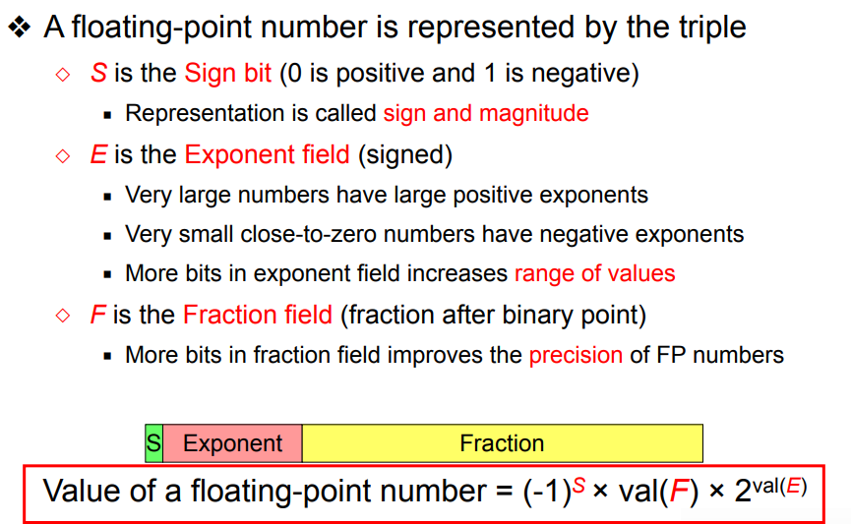
Floating Point Numbers

Slide 44
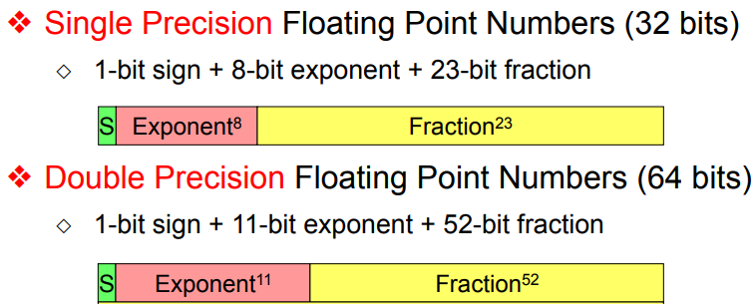
Floating Point Numbers

Slide 45
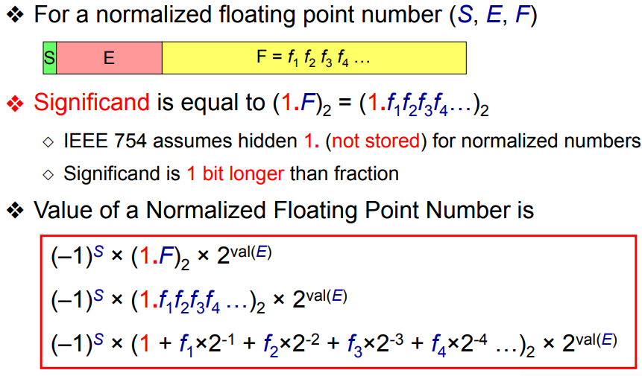
Floating Point Numbers
Normalized Floating Point

Slide 46
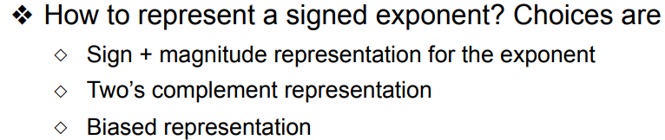

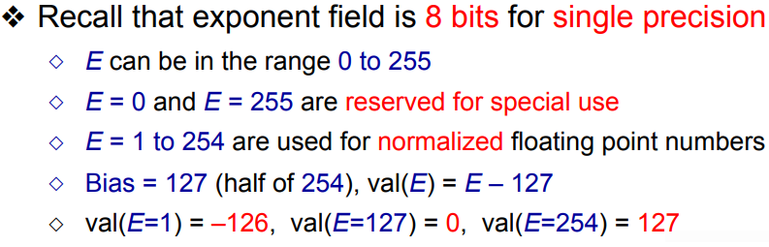
Floating Point Numbers
Biased Exponent Representation

Slide 47
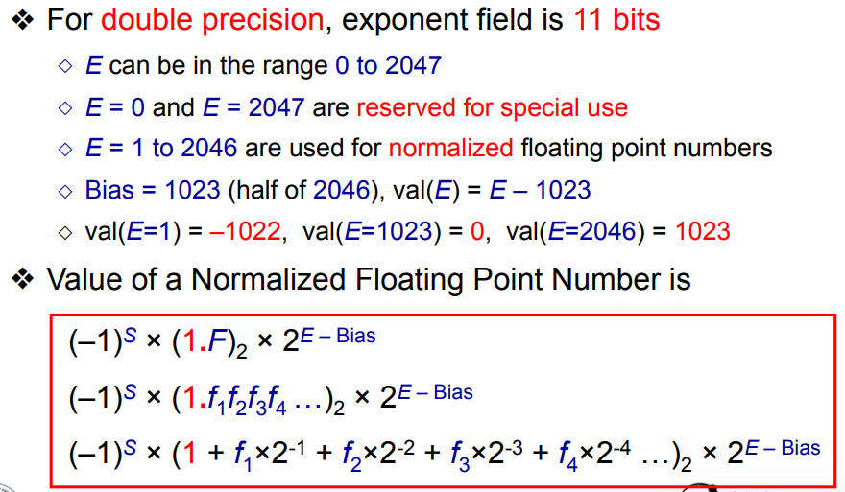
Floating Point Numbers
Biased Exponent Representation

Slide 48
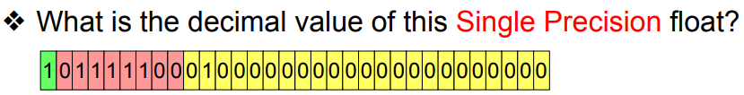


Floating Point Numbers
Biased Exponent Representation
Notes:
Decimal value of the IEEE floating-point number 010000010 01001100000000000000000 is 10.375.

Slide 49
Floating Point Numbers
Ex-1: Represent (54.25)₁₀ in IEEE754 binary format
Real number -> 54.25 = 32+16+4+2+.(1/4)
Binary -> 110110.01
Normalized -> 1. 1011001 x 2⁵
Mantissa -> 10110010000000000000000
Exponent -> 127 + 5 = 132 = 10000100
Floating Point Number -> 0 10000100 10110010000000000000000
        -> 0100_0010_0101_1001_0000_0000_0000_0000
        -> Hexadecimal -> 42590000

Slide 50
Floating Point Numbers
Ex-2: Represent (-0.6875)₁₀ in IEEE754 binary format
Real number -> -0.6875 = 0.5+0.125+0.0625 = (1/2 + 1/8 + 1/16)
Binary -> 0.1011
Normalized -> 1. 011 x 2⁻¹
Mantissa -> 01100000000000000000000
Exponent -> 127 - 1 = 126 = 01111110
Floating Point Number ->
        ->
        -> Hexadecimal ->

Slide 51
Floating Point Numbers
Ex-3: Represent (-54.6875)₁₀ in IEEE754 binary format
Real number -> -54.6875
Binary ->
Normalized ->
Mantissa ->
Exponent ->
Floating Point Number ->
Notes:
54​ =110110
The fractional part is 0.6875. To convert this to binary, multiply by 2 and take the integer part at each step:
0.6875×2=1.375 → Integer part: 1
0.375×2=0.750 → Integer part: 0
0.75×2=1.50 → Integer part: 1
0.5×2=1.00 → Integer part: 1
0.6875​ =0.1011
So, 54.6875​ = 110110.1011
-54.6875​ = 1 110110.1011

Slide 52
Floating Point Numbers
Ex-4: Floating point to decimal conversion
Floating point number -> 0xC2630000
        -> 1100 0010 0110 0011 0000 0000 0000 0000
Sign -> 1
Mantissa -> 11000110000000000000000
Exponent -> 10000100 = 132 , Actual value -> 132-127=5
Binary -> 1.1100011 x 2⁵
        -> 111000.11 = 56.75
Decimal Number -> -56.75
Notes:
What is the maximum value and min value in single precision FP numbers?

Slide 53
Floating Point Numbers
Arithmetic Operation: Addition/Subtraction
Align the exponents (smaller to larger)
Add or subtract significands
Normalize, overflow and underflow checks
Rounding
Stop if normalized else go to 3rd step
Examples

Slide 54
Example: A + B
A=1.234×10³ B=5.678×10¹
Step 1: Align the Exponents
  Adjust the smaller exponent
  A=1.234×10³ B=0.05678×10³
Step 2: Add the Mantissas
  Add the adjusted mantissas:
  A_{mantissa} + B_{mantissa} = 1.234 + 0.05678 = 1.29078
  So, the sum = 1.29078 ×10³
Step 3: Normalization
  The result is already normalized, so no further adjustment is needed.
Step 4: Rounding
  Depending on the precision of the floating-point format, the result may be rounded.
  The final result is approximately 1.291×10³

Slide 55
Floating Point Numbers
Arithmetic Operation: Multiplication
Add exponents & Subtract bias
Multiply significands
Normalize, overflow and underflow checks
Rounding
Stop if normalized else go to 3rd step
Set sign bit
Examples

Slide 56
Assignment - 1
Convert 3332 represented in Quaternary (base 4) to decimal
Convert 96 from decimal to Quaternary (base 4)
Multiply 3 X -3, -2 X 3
Multiply the following 2’s complement numbers
  1101 X 0101
  0101 X 1001
  1101 X 1010
Compute single precision floating point for the following
  4.25
  -4.25
Perform the following by converting them to single precision floating point numbers
  0.5 - 0.2775
  0.5 X (- 0.2775)

Slide 57
Coding
Coding: Representing a set of objects by a set of bit strings.
Code: The set of bit strings.
Code Word: A particular bit string in the Code.
Examples:
  Data Objects: Decimal Numbers, Characters.
  Non-data Objects: Machine states, Control Actions.
Notes:
Coding and encoding is the process of assigning a group of binary digits, commonly referred to as bits, to represent, tag, identify, or otherwise relate to multivalued items of information. By assigning each item of information a unique combination of bits (0s and 1s), we transform some given information into another form. In short, a CODE is a symbolic representation of information transform.
The bit combinations are referred to as words or code words.
Some other general definitions assigned to bit combinations are:-
Bit – a binary digit (1 or 0)
Byte - usually a group of 8 bits
Nibbles – usually a group of 4 bits
Words – a group of bytes; usually a word has two bytes or four nibbles.

Slide 58
Binary Codes For Decimal Numbers
To represent the 10 decimal digits, we need 4 bits.
Examples:
  4 bits Codes
    BCD (8421) - Binary Coded Decimal
    BCD (2421)
    Excess-3

Slide 59
Decimal Codes
Decimal BCD BCD Excess-3
(8421) 2421
0 0000 0000 0011
1 0001 0001 0100
2 0010 0010 0101
3 0011 0011 0110
4 0100 0100 0111
5 0101 1011 1000
6 0110 1100 1001
7 0111 1101 1010
8 1000 1110 1011
9 1001 1111 1100
BCD(8421) and BCD(2421) are weighed codes
BCD(2421) and Excess-3 are self-complementary codes

Slide 60
Exercise
Codes for 517
BCD:
2421:
Excess-3:
0101 0001 0111
1011 0001 1101
1000 0100 1010

Slide 61
Gray Code
One-bit changes between two successive code words
Binary Code and Gray Code (n = 3):
  Decimal Binary Code Gray Code
  0 000 000
  1 001 001
  2 010 011
  3 011 010
  4 100 110
  5 101 111
  6 110 101
  7 111 100

Slide 62
Binary Code to Gray Code Conversion
Convert n bit Binary code into n bit Gray Code:
Bit i of the Gray Code is obtained by comparing bits i and i+1 of the Binary Code:
  Add extra 0 to the left of the Binary code
  If bits i and i+1 in the Binary code are the same then bit i of the Gray code is 0, else bit i is 1.
Example:
Binary
10011
010011
1
1
0
1
0
Gray

Slide 63
Exercise
i and i+1: same → 0; else, 1
Binary
11101
011101
1 0 0 1 1
Gray
Gray
1 0 0 1 1
0 1 1 1 0 1
Binary

Slide 64
Coding for Error Control
Bit error occurs due to noise, etc., if
  0 sent is received as 1 or
  1 sent is received as 0
EDC (error detecting codes) to detect bit errors
ECC (error correcting codes) to correct bit errors

Slide 65
EDC: Repetition-2 Code
To send:
10110
send:
1100111100
If we receive
1000001101
we detect two errors but miss one
Detects any one bit error in a 2-bit block, but will miss two

Slide 66
ECC: Repetition-3 Code
To send:
10110
send:
111000111111000
If we receive
110000100001001
we correct two and miss two.
Detects any one bit error in a 3-bit block, but will miss any two or three

Slide 67
Parity-bit EDCs
Sender
Receiver
To send m bits, b₁, b₂, …, b_{m}.
Send m+1 bits, b₁, b₂, …, b_{m}, p, where p = b₁ ⊕ b₂ ⊕ …⊕ b_{m}
(b₁⊕ b₂ ⊕ … ⊕ b_{m} ⊕ p = 0)
if s=0, then 0 (or 2 or 4 or …) bit errors occurred, no error.
if s=1, then 1 (or 3 or 5 or …) bit errors occurred.
compute s = r₁⊕ r₂ ⊕ … ⊕ r_{m} ⊕ r_{m+1}
When r₁, r₂, …, r_{m}, r_{m+1} is received
b₁, b₂, …, b_{m}, p

Slide 68
Summary
Binary forms used in digital systems
  Positive/Negative numbers, addition/subtraction
  Arithmetic operations performed directly on negative numbers represented in Two’s complement.
  Floating point numbers
Hexadecimal numbers are used for shorthand representation of binary numbers.
Decimal numbers, characters, and actions encoded into binary strings.
Error-detecting and error-correcting codes use extra bits.

Slide 69
Combinational Logic Design Principles
  Boolean (Switching) Algebra
  Combinational Circuit Analysis
  Combinational Circuit Synthesis / Design

Slide 70
Boolean (Switching) Algebra

Slide 71
Boolean (‘Switching’) Algebra
Boolean values: 0, 1
Positive-logic convention: analog voltages LOW, HIGH → 0, 1
Signal values: denoted by variables (X, Y, etc.)
Complement: X′ (opposite of X)
AND: X ⋅ Y
OR: X + Y
Literal: a variable or its complement: X, X′
Expression: literals combined by AND, OR, parentheses
  (A ⋅ B′ ⋅ C + Q5) ⋅ RESET′
Equation: Variable = expression
  SUM = A’B’C + A’BC’ + AB’C’ + ABC

Slide 72
Basic Axioms
A variable can take only one of two values (0,1)
(A1) X = 0 if X ≠ 1 (A1’) X = 1 if X ≠ 0
NOT operation (The complement Operation):
(A2) If X = 0 then X ≠ 1 (A2’) If X = 1 then X ≠ 0
AND and OR operations (Multiplication and Addition):
(A3) 0 ⋅ 0 = 0 (A3’) 0 + 0 = 0
(A4) 1 ⋅ 1 = 1 (A4’) 1 + 1 = 1
(A5) 0 ⋅ 1 = 1 ⋅ 0 = 0 (A5’) 1 + 0 = 0 + 1 = 1

Slide 73
Theorems - Single Variable
Identity elements: (T1) X + 0 = X (T1’) X ⋅ 1 = X
Null elements: (T2) X + 1 = 1 (T2’) X ⋅ 0 = 0
Idempotency: (T3) X + X = X (T3’) X ⋅ X = X
Involution: (T4) (X′)′ = X
Complements: (T5) X + X′ = 1 (T5’) X ⋅ X′ = 0

Slide 74
Theorems - Multiple Variables
Commutativity: (T6) X + Y = Y + X (T6’) X ⋅ Y = Y ⋅ X
  The inputs of AND and OR gates can be interchanged.
Associativity: (T7) (X + Y) + Z = X +(Y + Z) (T7’) (X ⋅ Y) ⋅ Z = X ⋅ (Y ⋅ Z)
  The order of the input variables could be rearranged.
X
Z
≡
Y
Y
Z
X
Z
X
≡
Y
Y
X
Z

Slide 75
Theorems - Multiple Variables
Distributivity:
(T8) X ⋅ (Y + Z) = X ⋅ Y + X ⋅ Z
(T8’) X + Y ⋅ Z = (X + Y) ⋅ (X + Z)
  Multiplication distributes over addition; Addition distributes over multiplication!
Y
X
≡
Y
X
Z
Z
Y
X
≡
X
Y
Z
Z

Slide 76
Theorems - Multiple Variables
Covering: (T9) X + X ⋅ Y = X (T9’) X ⋅ (X + Y) = X
Proof:
(T9): X + X ⋅ Y = X ⋅ 1 + X ⋅ Y (theorem T1’)
= X ⋅ (1 + Y) (theorem T8- Distributivity)
= X ⋅ 1 (theorem T2)
= X (theorem T1’)
(T9’): X ⋅ (X + Y) = (X + 0) ⋅ (X + Y) (theorem T1)
= X + (0 ⋅ Y) (theorem T8’- Distributivity)
= X + 0 (theorem T2’)
= X (theorem T1)

Slide 77
Theorems-Multiple Variables
Combining: (T10) X ⋅ Y + X ⋅ Y′ = X
(T10’) (X + Y) ⋅ (X + Y′) = X
Proof:
(T10) X = X ⋅ 1 (theorem T1’)
= X ⋅ (Y + Y′) (theorem T5)
= X ⋅ Y + X ⋅ Y′ (theorem T8 - Distributivity)
(T10’) X = X + 0 (theorem T1)
= X + (Y ⋅ Y′) (theorem T5’)
= (X + Y) ⋅ (X + Y′) (theorem T8’ - Distributivity)
Covering and combining are used in minimizing logic functions.

Slide 78
Theorems-Multiple Variables
Consensus:
(T11) X ⋅ Y + X′ ⋅ Z + Y ⋅ Z = X ⋅ Y + X′ ⋅ Z
(T11’) (X + Y) ⋅ (X′ + Z) ⋅ (Y + Z) = (X + Y) ⋅ (X′ + Z)
Generalized Idempotency:
(T12) X + X + … + X = X
(T12’) X ⋅ X ⋅ … ⋅ X = X
Notes:
Proof: X.Y + X’.Z + Y.Z = X.Y + X’.Z
= X.Y + X’.Z + Y.Z (X+X’)
= X.Y + X’.Z + X.Y.Z +X’Y.Z
= X.Y(1+Z) + X’.Z(1+Y)
= X.Y + X’.Z

Slide 79

Theorems-Multiple Variables
DeMorgans Theorems
(T13) (X1 ⋅ X2 ⋅ … ⋅ Xn)′ = X1′ + X2′ + … + Xn′
(T13’) (X1 + X2 + … + Xn)′ = X1′ ⋅ X2′ ⋅ … ⋅ Xn′
Example: two-variable case
X1
≡
X1
(X1 ⋅ X2)′
(X1′ + X2′)
X2
X2
X1
≡
X1
(X1 + X2)′
(X1′ ⋅ X2′)
X2
X2

Slide 80
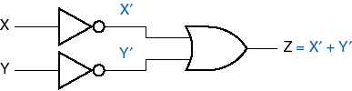


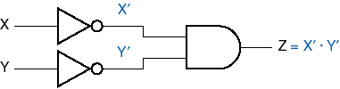




DeMorgan Symbol Equivalence

Slide 81
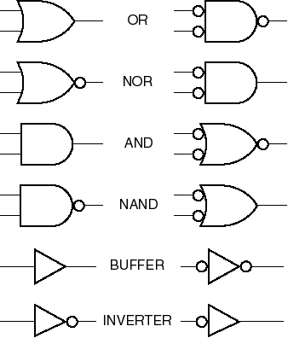
DeMorgan Symbols

Slide 82
Generalized DeMorgan’s Theorem
(T14) [ F (X1, X2, … , Xn, + , ⋅) ]′ = F (X1′, X2′, … , Xn′, ⋅ , +)
Example: F = (X1 ⋅ X2) + (X2 + X3)
X1
F′ = [(X1 ⋅ X2) + (X2 + X3)] ′
X2
X3
X1
F′ = (X1′ + X2′) ⋅ (X2′ ⋅ X3′)
X2
X3

Slide 83
Duality
Swap 0 & 1, AND & OR
  Result: Theorems still true
Why?
  Each axiom (A1-A5) has a dual (A1’-A5’)
Counterexample:
X + X ⋅ Y = X (T9) X. (1 + Y)
X ⋅ X + Y = X (dual) X + (0 .Y)
Mathematical definition : F is a Boolean Function; FD the dual function is:
FD (X1, X2, … , Xn, +, ⋅ , ′ ) = F (X1, X2, … , Xn, ⋅ , +, ′ )

Slide 84
Duality
Example:
F_{X1,X2,X3} = X1 + X2 ⋅ X3
FD_{X1,X2,X3} = X1 ⋅ (X2 + X3)
FD′_{X1,X2,X3} = (X1 ⋅ (X2 + X3))′ = X1′ + X2′ ⋅ X3′
= F_{X1′, X2′, X3′}
FD_{X1′,X2′,X3′} = X1’ ⋅ (X2’ + X3’)
FD′_{X1′,X2′,X3′} = (X1′ ⋅ (X2′ + X3′)′ = X1′′ + X2′′ ⋅ X3′′
= X1 + X2 ⋅ X3
F_{X1,X2,X3} = FD′_{X1′,X2′,X3′}

Slide 85
Duality and DeMorgan’s Theorem
F_{X1,X2, … ,Xn} = FD′_{X1′, X2′, … ,Xn′}
or: F′_{X1,X2, … ,Xn} = FD_{X1′, X2′, … ,Xn′}
Example:
X1
X1
F
F′
X2
X2
X3
X3
X1
X1
FD
FD_{X1’,X2’,X3’}
X2
X2
X3
X3

Slide 86
Exercise: DeMorgan/Duality
For the Boolean Expression F_{A,B,C} = AB + AB′C + BC′ Find: F′, FD, FD_{A′,B′,C′}, FD′_{A′,B′,C′}
F′ = [A⋅B + A⋅B′⋅C + B⋅C′]′
= (A′ + B′)⋅(A′ + B + C′)⋅(B′ + C)
FD = (A + B)⋅(A + B′ + C)⋅(B + C′)
FD_{A′,B′,C′} = (A′ + B′)⋅(A′ + B + C′)⋅(B′ + C)
FD′_{A′,B′,C′} = [(A′ + B′)⋅(A′ + B + C′)⋅(B′ + C)] ′
= A⋅B + A⋅B′⋅C + B⋅C′

Slide 87
Representation of Logic Functions
Truth table with 2^{n} rows, n: the number of variables
Literal: a variable or its complement
  X, Y′
n-variable minterm: product term with n literals
  X′⋅Y⋅Z
n-variable maxterm: sum term with n literals
  X+Y′+Z

Slide 88
Canonical Representation
Canonical Sum (Sum of Products - SOP):
  Sum of minterms corresponding to input combinations for which the function produces a 1 output.
  F_{X,Y,Z} = Σ (1, 3, 6)
  F = X′⋅Y′⋅Z + X′⋅Y⋅Z + X⋅Y⋅Z′
Canonical Product (Product of Sums - POS):
  Product of maxterms corresponding to input combinations for which the function produces a 0 output.
  F_{X,Y,Z} = Π (0, 2, 4, 5, 7)
  F = (X+Y+Z) ⋅ (X+Y′+Z) ⋅ (X′+Y+Z) ⋅ (X′+Y+Z′) ⋅ (X′+Y′+Z′)

Slide 89
Canonical Sum Implementation
F = X′⋅Y′⋅Z + X′⋅Y⋅Z + X⋅Y⋅Z′
X′⋅Y′⋅Z
X
X′⋅Y⋅Z
Y
F
Z
X⋅Y⋅Z′

Slide 90
Canonical Product Implementation
F = (X+Y+Z) ⋅ (X+Y′+Z) ⋅ (X′+Y+Z) ⋅ (X′+Y+Z′) ⋅ (X′+Y′+Z′)
(X+Y+Z)
X
(X+Y′+Z)
Y
(X′+Y+Z)
F
Z
(X′+Y+Z′)
(X′+Y′+Z′)

Slide 91
Logic Function Simplification
F = X′⋅Y′⋅Z + X′⋅Y⋅Z + X⋅Y⋅Z′
= X′ (Y′⋅Z + Y⋅Z) + X⋅Y⋅Z′
= X′ ((Y′ + Y) ⋅ Z) + X⋅Y⋅Z′
= X′ (1 ⋅ Z) + X⋅Y⋅Z′
= X′⋅Z + X⋅Y⋅Z′
X
X′⋅Z
Y
F
X⋅Y⋅Z′
Z
Notes:
a+a’b = a(1+b) + a’b = a+ab+a’b = a+b(a+a’) = a+b

Slide 92
Exercise
F(A,B,C) = Σ (0,2,4,7)
Write: The Truth Table; The Canonical Sum (SOP); The Canonical Product (POS)
Row | A | B | C | F | Minterms | Maxterms
0 | 0 | 0 | 0
1 | 0 | 0 | 1
2 | 0 | 1 | 0
3 | 0 | 1 | 1
4 | 1 | 0 | 0
5 | 1 | 0 | 1
6 | 1 | 1 | 0
7 | 1 | 1 | 1
SOP: F = A′⋅B′⋅C′ + A′⋅B⋅C′ + A⋅B′⋅C′ + A⋅B⋅C
POS: F = (A+B+C’) ⋅ (A+B′+C’) ⋅ (A′+B+C′) ⋅ (A′+B′+C)

Slide 93
Combinational Circuit Analysis

Slide 94
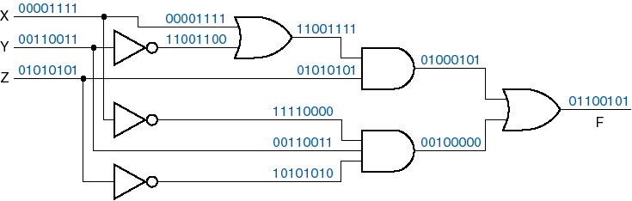
Combinational Circuit Analysis
Logic Circuit → Logic Function → Truth Table

Slide 95
Logic Circuit → Logic Function → Truth Table
Example 1:
A
(A⋅B)
(A⋅B) + C
B
F
C
F = (A+C) ⋅ ((A⋅B) + C)
(A+C)
A | B | C | AB | AB+C | A+C | F
0 | 0 | 0 | 0 | 0 | 0 | 0
0 | 0 | 1 | 0 | 1 | 1 | 1
0 | 1 | 0 | 0 | 0 | 0 | 0
0 | 1 | 1 | 0 | 1 | 1 | 1
1 | 0 | 0 | 0 | 0 | 1 | 0
1 | 0 | 1 | 0 | 1 | 1 | 1
1 | 1 | 0 | 1 | 1 | 1 | 1
1 | 1 | 1 | 1 | 1 | 1 | 1

Slide 96
Logic Function Simplification
Example 1:
F = (A+C) ⋅ ((A⋅B) + C)
= A ⋅ (A⋅B + C) + C ⋅ (A⋅B + C)
= A⋅A⋅B + A⋅C + C⋅A⋅B + C⋅C
= A⋅B + A⋅C + A⋅B⋅C + C
= (A⋅B + A⋅B⋅C) + (A⋅C + C)
= A⋅B ⋅ (1 + C) + ((A + 1) ⋅ C)
= A⋅B + C
A
A⋅B
Same function,
different circuit
F = A⋅B + C
B
C

Slide 97
Example 2:
A
(A+B)′
B
F
(B⋅C′)′
F = [(A+B)′ ⋅ (B⋅C′)′]′
C
A | B | C | F
0 | 0 | 0 | 0
0 | 0 | 1 | 1
0 | 1 | 0 | 1
0 | 1 | 1 | 1
1 | 0 | 0 | 1
1 | 0 | 1 | 1
1 | 1 | 0 | 1
1 | 1 | 1 | 1
F_{A,B,C} = Σ (1, 2, 3, 4, 5, 6, 7)
OR
F_{A,B,C} = Π (0)

Slide 98
Example 2 (Contd.):
A
(A + B)′
B
F
(B ⋅ C′)′
C
A
(A + B)′
B
F
≡
(B ⋅ C′)′
C
F = A+B + B⋅C’
A
(A + B)
B
(B ⋅ C′)
C

Slide 99
Example 2 (Contd.):
F = [(A+B)’ ⋅ (B⋅C’)’]’
(A+B)’’ + (B⋅C’)’’ using Demorgan’s theorem
= A+B + B⋅C’
= A+B ⋅ (1 + C’)
= A + B ⋅ 1
= A + B
A
F
B

Slide 100
Combinational Analysis Review:

Slide 101
Combinational Analysis Review:
Logic Circuit → Logic Function → Truth Table
Analyze a combinational logic circuit by obtaining a formal description of its logic function
Outputs of a combinational logic circuit depends only on its current inputs (not on history)
Kinds of combinational analysis:
  exhaustive (truth table)
  algebraic (expressions)

Slide 102
Example:
A
(A+B)′
B
F
(B⋅C′)′
C
F = [(A+B)′ ⋅ (B⋅C′)′]′
 | A | B | C | F
0 | 0 | 0 | 0 | 0
1 | 0 | 0 | 1 | 1
2 | 0 | 1 | 0 | 1
3 | 0 | 1 | 1 | 1
4 | 1 | 0 | 0 | 1
5 | 1 | 0 | 1 | 1
6 | 1 | 1 | 0 | 1
7 | 1 | 1 | 1 | 1
F_{A,B,C}= Σ (1,2,3,4,5,6,7)
F = A’B’C+A’BC’+A’BC+AB’C’+AB’C+ABC’+ABC
F_{A,B,C} = Π (0)
F = (A+B+C)
F = A + B
A
F
B

Slide 103
Combinational Circuit Synthesis

Slide 104
Combinational Circuit Synthesis
Truth Table → Logic Function → Logic Circuit
Logic Function:
    The canonical sum expression.
    The canonical product expression.
The canonical Implementations:
    AND-OR and its equivalent NAND-NAND
    OR-AND and its equivalent NOR-NOR
Logic Function minimization:
    Simplifying the logic function to reduce the number of gates.
Minimization methods:
    Using theorems
    Karnaugh map

Slide 105
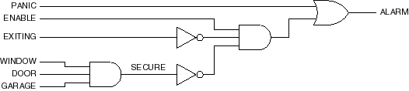
Combinational Circuit Design
Sometimes you can write an equation or equations directly using ‘logic’.
Example (alarm circuit):
ALARM = PANIC + ENABLE . EXITING’ . SECURE’
SECURE = WINDOW . DOOR . GARAGE
ALARM = PANIC + ENABLE . EXITING’ . (WINDOW . DOOR . GARAGE)’

Slide 106
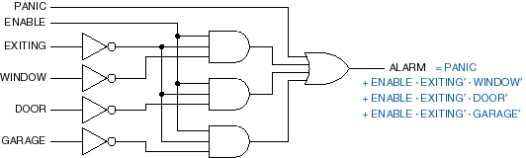
Example (Contd): Alarm Circuit Transformation
ALARM = PANIC + ENABLE . EXITING’ . (WINDOW . DOOR . GARAGE)’
ALARM = PANIC + ENABLE . EXITING’ . WINDOW + ENABLE . EXITING’ . DOOR’ + ENABLE .
EXITING’ . GARAGE’
Sum-of-products form
  Useful for programmable logic devices
  Multiply out

Slide 107
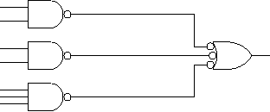
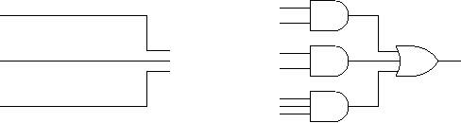
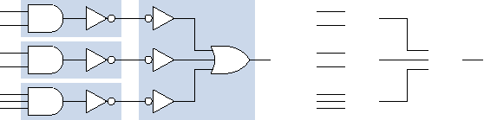
Sum-of-Products Form
AND-OR
NAND-NAND

Slide 108
NAND-NAND Implementation
F = X′⋅Y′⋅Z + X′⋅Y⋅Z + X⋅Y⋅Z′
(X′⋅Y′⋅Z)′
X′⋅Y′⋅Z
X
X′⋅Y⋅Z
(X′⋅Y⋅Z)′
Y
F
Z
(X⋅Y⋅Z′)′
X⋅Y⋅Z′
F = [(X′⋅Y′⋅Z)′⋅ (X′⋅Y⋅Z)′ ⋅ (X⋅Y⋅Z′)′]′
F = X′⋅Y′⋅Z + X′⋅Y⋅Z + X⋅Y⋅Z’
≡

Slide 109
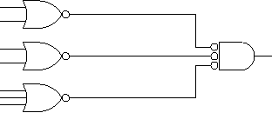
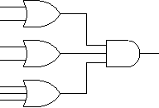
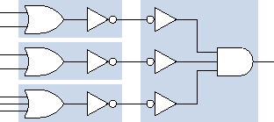
Product-of-Sums Form
OR - AND
NOR - NOR

Slide 110
NOR-NOR Implementation
F = (X + Y + Z)⋅(X + Y’ + Z)⋅(X’ + Y + Z)⋅(X’ + Y + Z’)⋅(X’ + Y’ + Z’)
X
Y
Z

Slide 111
Minimization Example: Prime Number Detector
Row | N3 | N2 | N1 | N0 | F
0 | 0 | 0 | 0 | 0 | 0
1 | 0 | 0 | 0 | 1 | 1
2 | 0 | 0 | 1 | 0 | 1
3 | 0 | 0 | 1 | 1 | 1
4 | 0 | 1 | 0 | 0 | 0
5 | 0 | 1 | 0 | 1 | 1
6 | 0 | 1 | 1 | 0 | 0
7 | 0 | 1 | 1 | 1 | 1
8 | 1 | 0 | 0 | 0 | 0
9 | 1 | 0 | 0 | 1 | 0
10 | 1 | 0 | 1 | 0 | 0
11 | 1 | 0 | 1 | 1 | 1
12 | 1 | 1 | 0 | 0 | 0
13 | 1 | 1 | 0 | 1 | 1
14 | 1 | 1 | 1 | 0 | 0
15 | 1 | 1 | 1 | 1 | 0
Truth table → canonical sum
(sum of minterms)
F = Σ_{N3N2N1N0} (1,2,3,5,7,11,13)

Slide 112
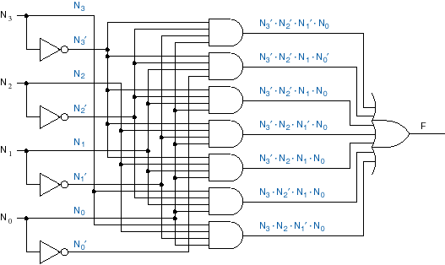
Example (contd.): Minterm list → Canonical Sum
F = Σ_{N3N2N1N0} (1,2,3,5,7,11,13)
= N₃’. N₂’. N₁’. N₀ + N₃’. N₂’. N₁. N₀’ + N₃’. N₂’. N₁. N₀ + N₃’. N₂. N₁’. N₀
+ N₃’. N₂. N₁. N₀ + N₃. N₂’. N₁. N₀ + N₃. N₂. N₁’. N₀

Slide 113
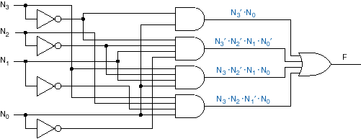
Example (Contd.): Algebraic Simplification
(T10) X ⋅ Y + X ⋅ Y′ = X
F = Σ_{N3N2N1N0} (1,2,3,5,7,11,13)
= N₃’. N₂’. N₁’. N₀ + N₃’. N₂’. N₁. N₀ + N₃’. N₂. N₁’. N₀ + N₃’. N₂. N₁. N₀ + …
= (N₃’. N₂’. N₁’. N₀ + N₃’. N₂’. N₁. N₀) + (N₃’. N₂. N₁’. N₀ + N₃’. N₂. N₁. N₀) + …
= N₃’. N₂’. N₀ + N₃’. N₂. N₀ + …
Reduce number of gates and gate inputs

Slide 114
Karnaugh Maps
A karnaugh map is a representation of the truth table by a matrix of cells, where each cell corresponds to a minterm (or a maxterm) of the logic function.
For n-variable function, we need 2^{n} rows truth table and 2^{n} cells.
The cell number is equivalent to the row number in the truth table.
The truth table values are copied into their corresponding cells.

Slide 115
Steps to Solve Expression using K-map
Select the K-map according to the number of variables
Identify minterms or maxterms as given in the problem
For SOP put 1’s in blocks of K-map respective to the minterms (0’s elsewhere)
For POS put 0’s in blocks of K-map respective to the maxterms (1’s elsewhere)
Make rectangular groups containing total terms in power of two like 2,4,8 ..(except 1) and try to cover as many elements as you can in one group
From the groups made in step 5 find the product terms and sum them up for SOP form

Slide 116
Two-Variable Karnaugh Map
Example 1:
F = XY′ + XY
X
X
Y
0
1
Row | X | Y | F
0 | 0 | 0 | 0
1 | 0 | 1 | 0
2 | 1 | 0 | 1
3 | 1 | 1 | 1
0
0
0
2
1
Y
1
1
0
3
1
Simplification: F = X(Y′ + Y) = X⋅1 = X

Slide 117
Example 2
F = X′Y′ + X′Y
X
X
Y
0
1
Row | X | Y | F
0 | 0 | 0 | 1
1 | 0 | 1 | 1
2 | 1 | 0 | 0
3 | 1 | 1 | 0
0
0
1
2
0
1
1
1
3
0
Y
Simplification: F = X′(Y′ + Y) = X′⋅1 = X′

Slide 118
Three-Variable Karnaugh Map
Example 3:
F = X′Y′Z′ + X′Y′Z + XY′Z′ + XY′Z
X
Row | X | Y | Z | F
0 | 0 | 0 | 0 | 1
1 | 0 | 0 | 1 | 1
2 | 0 | 1 | 0 | 0
3 | 0 | 1 | 1 | 0
4 | 1 | 0 | 0 | 1
5 | 1 | 0 | 1 | 1
6 | 1 | 1 | 0 | 0
7 | 1 | 1 | 1 | 0
XY
Z
00
01
11
10
0
0
1
2
0
6
0
4
1
1
1
1
3
0
7
0
5
1
Z
Y
Simplification: F = X′Y′(Z′ + Z) + XY′(Z′ + Z) = X′⋅Y′ + XY′ = (X′ + X)Y′= Y′

Slide 119
Karnaugh-Map Usage
Plot 1s corresponding to minterms of function.
Circle largest possible rectangular sets of 1s.
  number of 1s in set must be power of 2
  OK to cross edges
Read off product terms, one per circled set.
  Variable is 1 → include variable
  Variable is 0 → include complement of variable
  Variable is both 0 and 1 → variable not included
Circled sets and corresponding product terms are called ‘prime implicants’
Minimum number of gates and gate inputs

Slide 120
Example 1
X
XY
Z
00
01
11
10
Combining Two cells:
0
0
1
2
6
4
1
I) Cells (0,1): X=Y=0; Z=0,1
Product term: X’Y’
Cells (4,5): X=1; Y=0; Z=0,1
Product term : XY’
1
1
1
3
7
5
1
Z
Y
OR:
II) Cells (0,4): Y=0; Z=0; X=0,1
Product term: Y’Z’
Cells (1,5): Y=0; Z=1; X=0,1
Product term : Y’Z
XY
Z
00
01
11
10
0
0
1
2
6
4
1
1
1
1
3
7
5
1

Slide 121
Example 1 (Contd.)
X
XY
Z
00
01
11
10
Combining four cells
III) Cells (0,1,4,5)
X=0,1; Z=0,1; Y=0
The product term: Y’
0
0
1
2
6
4
1
1
1
1
3
7
5
1
Z
The sum of products expression of F:
From I) F =X’Y’+XY’ or
From II) F=Y’Z’+Y’Z or:
From III) F =Y’
Y

Slide 122
Example 2
Combine cells (0,2,6,4)
X=0,1; Y= 0,1; Z=0
Product Term: Z’
Combine cells (4,5)
X=1; Y=0; Z=0,1
Product Term: XY’
F = XY’+Z’
X
XY
Z
00
01
11
10
0
0
1
2
1
6
1
4
1
1
1
3
7
5
1
Z
Y
The canonical sum is: F=X’Y’Z’+XYZ’+XY’Z’+XY’Z+XYZ’

Slide 123
Exercise
XY
Z
00
01
11
X
10
0
0
1
2
1
6
4
1
1
1
1
3
7
1
5
1
Z
Y

Slide 124
Definitions
A logic function P implies a logic function F if for every input combination for which P=1, then F=1 also. (P is an implicant of F)
Any minterm or combination of minterms in the canonical sum expression is an implicant of the output function
A prime implicant is a group of combined minterms that can’t be combined with any other minterm or group of minterms
Essential prime implicant is a prime implicant in which one or more minterms are unique (i.e at least one minterm is not contained in any other prime implicant. A unique minterm is called an Essential 1-Cell
A minimal sum of a logic function is a sum-of-products expression for F such that no sum-of-products expression for F has fewer product terms.

Slide 125
Example 1
XY
Z
00
01
11
X
10
Combining (0,2)
Product term: X’Z’
Combining (2,3)
Product term: X’Y
Combining (3,7)
Product term: YZ
0
0
1
2
1
6
4
1
1
3
1
7
1
5
Z
Largest possible set
Y
Unique minterm
X’Z’, X’Y, and YZ are prime implicants
X’Z’, YZ are essential prime implicants
X’Y is non-essential prime implicant (redundant) because all its minterms are covered in the other essential prime implicants
F= X’Z’+X’Y+YZ OR: F = X’Z’+YZ (the minimal sum of F)

Slide 126
Example 2
XY
Z
00
01
11
10
X
The prime implicants:
0
0
1
2
1
6
4
1
1- (0,2) X’Z’
1
1
3
1
7
1
5
1
2- (0,4) Y’Z’
Z
3- (2,3) X’Y
No essential prime implicant!
Y
6 -(5,7) XZ
4- (3,7) YZ
5- (4,5) XY’
Two possible minimal sums:
1- Using the prime implicants 1,4,and 5; F= X’Z’+YZ+XY’
2- Using the prime implicants 2,3,and 6; F= Y’Z’+ X’Y+XZ

Slide 127
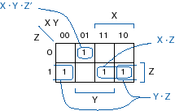
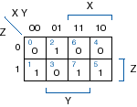
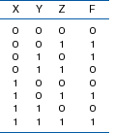
Example 3: F = S(1,2,5,7)

Slide 128
Summary
Load the minterms and maxterms into the K-map by placing the 1’s and 0’s in the appropriate cells.
Look for groups of minterms and write the corresponding product
terms (the prime implicants):
  The group size should be a power of 2.
  Find the largest groups of minterms first then find smaller groups of minterms until all groups are found and all 1-cells are covered.
Determine the essential prime implicants.
Select all essential prime implicants and the minimal set of the remaining prime implicants that cover the remaining 1’s.
Its possible to get more that one equally simplified expression if more than one set of the remaining prime implicants contains the same number of minterms.

Slide 129
Four-Variable Karnaugh Map
WX
YZ
00
01
11
W
10
00
0
4
12
8
01
1
5
13
9
11
3
7
15
11
Z
Y
10
2
6
14
10
X

Slide 130
Example 5
Row | W | X | Y | Z | F
0 | 0 | 0 | 0 | 0 | 1
1 | 0 | 0 | 0 | 1 | 0
2 | 0 | 0 | 1 | 0 | 1
3 | 0 | 0 | 1 | 1 | 0
4 | 0 | 1 | 0 | 0 | 0
5 | 0 | 1 | 0 | 1 | 1
6 | 0 | 1 | 1 | 0 | 0
7 | 0 | 1 | 1 | 1 | 1
8 | 1 | 0 | 0 | 0 | 1
9 | 1 | 0 | 0 | 1 | 0
10 | 1 | 0 | 1 | 0 | 1
11 | 1 | 0 | 1 | 1 | 0
12 | 1 | 1 | 0 | 0 | 0
13 | 1 | 1 | 0 | 1 | 1
14 | 1 | 1 | 1 | 0 | 0
15 | 1 | 1 | 1 | 1 | 1
F=
W’X’Y’Z’+
W’X’YZ’+
W’XYZ’+
W’XYZ+
WX’Y’Z’+
WX’YZ’+
WXY’Z’+
WXYZ

Slide 131
Example 5(Contd.)
WX
YZ
00
01
11
W
10
Essential prime implicants:
00
1
1
The product term: XZ
01
1
1
Z
The product term : X’Z’
11
1
1
Y
10
1
1
X
F = XZ + X’Z’

Slide 132
Example 6
WX
YZ
00
01
11
W
10
Essential prime implicants:
00
1
1
The product term: X’Z
01
1
1
Z
11
1
1
The product term : XZ’
Y
10
1
1
X
F = X'Z + XZ’

Slide 133
Exercise
Row | W | X | Y | Z | F
0 | 0 | 0 | 0 | 0 | 1
1 | 0 | 0 | 0 | 1 | 1
2 | 0 | 0 | 1 | 0 | 1
3 | 0 | 0 | 1 | 1 | 0
4 | 0 | 1 | 0 | 0 | 1
5 | 0 | 1 | 0 | 1 | 1
6 | 0 | 1 | 1 | 0 | 1
7 | 0 | 1 | 1 | 1 | 0
8 | 1 | 0 | 0 | 0 | 1
9 | 1 | 0 | 0 | 1 | 1
10 | 1 | 0 | 1 | 0 | 0
11 | 1 | 0 | 1 | 1 | 0
12 | 1 | 1 | 0 | 0 | 1
13 | 1 | 1 | 0 | 1 | 1
14 | 1 | 1 | 1 | 0 | 1
15 | 1 | 1 | 1 | 1 | 0
WX
YZ
00
01
11
10
W
00
0
4
12
8
01
1
5
13
9
11
3
7
15
11
Z
Y
10
2
6
14
10
X

Slide 134
Exercise (Contd.)
WX
YZ
00
01
11
10
W
00
0
1
4
1
12
1
8
1
01
1
1
5
1
13
1
9
1
11
3
7
15
11
Z
Y
10
2
1
6
1
14
1
10
X
F = Y’ + W’Z’ + XZ’

Slide 135
Example 7
WX
YZ
00
01
11
10
The prime implicants:
W’X’
W’Y’
W’Z
XYZ
WXY
The essential prime implicants:
W’X’
W’Y’
WXY
Cell 7 is not covered by any of the essential prime implicants. Its covered by two non-essential prime implicant. We choose the one with the less number of variables which is W’Z
W
00
0
1
4
1
12
8
01
1
1
5
1
13
9
11
3
1
7
1
15
1
11
Z
Y
10
2
1
6
14
1
10
X
F= W’X’+W’Y’+WXY+W’Z

Slide 136
Exercise
FW,X,Y,Z= Σ (0,1,2,3,4,6,7,8,9,12,14)

Slide 137
Simplifying the Product of Sums
Plot 0s corresponding to maxterms of function.
Circle largest possible rectangular sets of 0s.
  # of 0s in set must be power of 2
  OK to cross edges
Read off product terms, one per circled set.
  Variable is 0 → include variable
  Variable is 1 → include complement of variable
  Variable is both 1 and 0 → variable not included
Circled sets and corresponding product terms are called ‘prime implicants’
Minimum number of gates and gate inputs

Slide 138
Example 8
WX
YZ
00
01
11
10
W
The prime implicants:
00
0
0
4
12
0
8
0
Cells (0,1,8,9): X=0, Y=0
The sum term: X+Y
01
1
0
5
13
9
0
Z
11
3
7
15
11
Cells (8,10,12,14): W=1, Z=0
The sum term: W’+Z
Y
10
2
6
14
0
10
0
The two prime implicants are essential prime implicants and cover all zeros
X
The minimal product of sums: F = (X + Y) . (W’ + Z)

Slide 139
Exercise
WX
YZ
00
01
11
W
10
Row | W | X | Y | Z | F
0 | 0 | 0 | 0 | 0 | 1
1 | 0 | 0 | 0 | 1 | 1
2 | 0 | 0 | 1 | 0 | 1
3 | 0 | 0 | 1 | 1 | 0
4 | 0 | 1 | 0 | 0 | 1
5 | 0 | 1 | 0 | 1 | 1
6 | 0 | 1 | 1 | 0 | 1
7 | 0 | 1 | 1 | 1 | 0
8 | 1 | 0 | 0 | 0 | 1
9 | 1 | 0 | 0 | 1 | 1
10 | 1 | 0 | 1 | 0 | 0
11 | 1 | 0 | 1 | 1 | 0
12 | 1 | 1 | 0 | 0 | 1
13 | 1 | 1 | 0 | 1 | 1
14 | 1 | 1 | 1 | 0 | 1
15 | 1 | 1 | 1 | 1 | 0
00
0
4
12
8
01
1
5
13
9
11
3
7
15
11
Z
Y
10
2
6
14
10
X
Essential prime implicants:
(3,7,15,11): Z=1, Y=1; The sum term: Z’+Y’
(10,11): W=1, X=0,Y=1; The sum term: W’+X+Y’
F=(Z’+Y’).(W’+X+Y’)

Slide 140
Simplifying POS - Another method
Complement the function. Use K-map to get the minimal sum of the complement function. Complement the minimal sum to get the minimal product
WX
YZ
00
01
11
W
10
1. The function is complemented and represented using K-map:
00
0
1
4
12
1
8
1
2. The essential prime implicants are: WZ’, X’Y
01
1
1
5
13
9
1
11
3
7
15
11
Z
3. The minimal Sum: M = X’Y’ + WZ’
Y
10
2
6
14
1
10
1
4. F = M’ = (X’Y’+WZ’)’ = (X+Y).(W’+Z)
X

Slide 141
Minimal Product of Sums vs. Minimal Sum of Products:
Compare the minimal product and the minimal sum designs to find the best (least # of gates) realization.
In the previous example:
The minimal sum is: F = W’X + W’Y + XZ + YZ
The minimal product: F = (X + Y) . (W’ + Z)
∴ The minimal product implementation is cheaper.

Slide 142
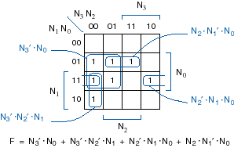
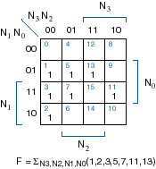
Prime-Number Detector (again)

Slide 143
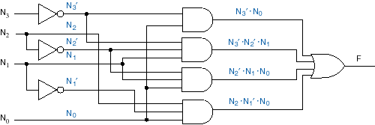
Prime-number detector (contd.)
When we solved algebraically, we missed one simplification -- the circuit below has three less gate inputs.

Slide 144
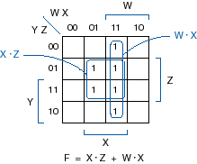
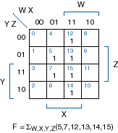
Example 9

Slide 145
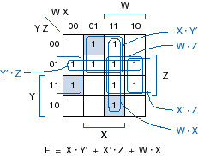
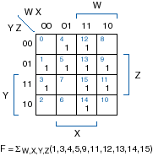
Example 10

Slide 146
Don’t Care Conditions
In some applications, the Boolean function for certain combinations of the input variables is not specified. The corresponding minterms (maxterms) are called “don’t care minterms(maxterms)”.
In K-map , these are represented by ‘d’.
Since the output function for those minterms(maxterms) is not specified, those minterms(maxterms) could be combined with the adjacent 1 cells (0-cells) to get a more simplified sum-of-products (product-of-sums) expression.

Slide 147
Example 11
Build a logic circuit that determines if a decimal digit is ≥ 5
The decimal digits (0,1,2,...,9) are represented by 4 bit BCD code.
The logic circuit should have 4 input variables and 1 output.
There are 16 different input combinations but only 10 of them are used.
The logic function should produce 0 if the number is < 5,
and 1 if it is ≥ 5.

Slide 148
Example 11 (Contd.): Truth Table
Row | W | X | Y | Z | F
0 | 0 | 0 | 0 | 0 | 0
1 | 0 | 0 | 0 | 1 | 0
2 | 0 | 0 | 1 | 0 | 0
3 | 0 | 0 | 1 | 1 | 0
4 | 0 | 1 | 0 | 0 | 0
5 | 0 | 1 | 0 | 1 | 1
6 | 0 | 1 | 1 | 0 | 1
7 | 0 | 1 | 1 | 1 | 1
8 | 1 | 0 | 0 | 0 | 1
9 | 1 | 0 | 0 | 1 | 1
10 | 1 | 0 | 1 | 0 | d
11 | 1 | 0 | 1 | 1 | d
12 | 1 | 1 | 0 | 0 | d
13 | 1 | 1 | 0 | 1 | d
14 | 1 | 1 | 1 | 0 | d
15 | 1 | 1 | 1 | 1 | d

Slide 149
Example 11(Contd.)- K-Map
WX
YZ
00
01
11
10
The Minimal Sum:
Combining the ‘1’ cells only, the minimal sum is:
F = WX’Y’+W’XZ+W’XY
Combining the don’t care minterms with the ‘1’ cells, the minimal sum is:
F = W+XZ+XY
W
00
0
4
12
d
8
1
01
1
5
1
13
d
9
1
11
3
7
1
15
d
11
d
Z
Y
10
2
6
1
14
d
10
d
X

Slide 150
Multiple-Output Minimization
Most digital applications require multiple outputs derived from the same input variables.
X
F1
Y
Logic Circuit
Z
F2
Each output function could be minimized using K-map and realized independently.
The output functions could share one or more product terms (prime implicant) which reduces the total number of gates.

Slide 151
Example 12
F1 = XZ + YZ’
F2 = XY’ + YZ’
F2
XY
Z
00
01
11
10
F1
X
XY
Z
00
01
11
10
X
0
0
2
1
6
1
4
1
0
0
2
1
6
1
4
1
1
3
7
5
1
Z
1
1
3
7
1
5
1
Z
Y
XY
Z
00
01
11
10
Y
X
0
0
2
1
6
1
4
Find the common terms
The common term is: YZ’
1
1
3
7
5
1
Z
Y

Slide 152
Example 12 (Contd.) – Logic Diagram
Independent realization Minimal realization
F1= XZ+YZ’
F2= XY’+YZ’
F1
X
Y
Z
F2
F1
X
Y
F2
Z
YZ’

Slide 153
Timing Hazards
The Truth Table determines the Steady State behavior of a Combinational Logic Circuit
Transient behavior:
  Output could produce glitches when input variables change.
  Glitches occur when the paths between inputs and output have different delays.
  Timing Hazards refer to the possibility of having glitches during input transitions.
Hazards:
  Definitions.
  Finding hazards.
  Eliminating hazards.

Slide 154
Definitions
Static-1 Hazard: Two input combinations that:
  Differ in only one variable.
  Both produce logic 1.
  Possibly produce Logic 0 glitch during input variable transition
Static-0 Hazard: Two input combinations that
  Differ in only one variable
  Both produce logic 0
  Possibly produce Logic 1 glitch during input variable transition
Dynamic hazards:
  The output could change more than once during input transitions
  Caused by multiple paths with different delays from input to the output
1
0
1
0
Notes:
Static-1 Hazard: If the output is currently at logic state 1 and after the input changes its state, the output momentarily changes to 0 before settling on 1, then it is a Static-1 hazard.
Static-0 Hazard: If the output is currently at logic state 0 and after the input changes its state, the output momentarily changes to 1 before settling on 0, then it is a Static-0 hazard.

Slide 155
Example
F = YZ + XZ’
Delay in each gate is T .
Input changes from XYZ = 111 to 110
X
Y
Y
Z
Z
F
Z’
YZ
X
XZ’
F
T
glitch

Slide 156
Finding Timing hazards using K-map
AND-OR Circuits:
Static 0 hazards do not exist in the sum-of products (AND-OR) implementation.
Static 1 hazards are possible
The K-map of the function F in the previous example:
Cell 6 and 7 are covered in two product terms.
Faster
XY
Z
00
01
11
10
X
Y
1
1→0
1→0
F
Z
0
0
2
6
1
4
1
1→0→1
X
1
0→1
1
1
3
1
7
1
5
Z
Static 1 hazard
Y
Notes:
Step-1: Write down the output of the digital circuit, say Y.
Step-2: Draw the K-map for this function Y and note all adjacent 1’s.
Step-3: If there exists any pair of cells with 1’s which do not occur to be in the same group ( i.e. prime implicant), it indicates the presence of a static-1 hazard. Each such pair is a static-1 hazard.

Slide 157
Timing hazards in OR-AND Circuits
OR - AND Circuits:
Static 1 hazards do not exist in the products-of sum (OR-AND) implementation.
Static 0 hazards are possible
The minimal product of F = (X+Z)(Y+Z’)
Cell 0 and Cell 1 are covered in two sum terms
Static 0 hazard occurs when inputs switched between 000 to 001
Faster
XY
Z
00
01
11
10
X
X
0
0→1
F
0→1→0
0
0
0
2
0
6
4
Z
1→0
Y
0
1→0
1
1
0
3
7
5
0
Z
Static 0 hazard
Y

Slide 158
Eliminating Timing Hazards
AND-OR Circuit
Add a prime implicant that combines the two inputs that cause static 1 hazard.
XY
Z
00
01
11
10
X
Y
1
1→0
F
0
0
2
6
1
4
1
Z
1→0
1
X
1
0→1
1
1
3
1
7
1
5
Z
1
Y
The hazard-free circuit
Cells 6 & 7 are combined: XY

Slide 159
Eliminating Timing Hazards
OR - AND Circuit
Add a prime implicant that combines the two inputs that cause static 0 hazard.
XY
Z
00
01
11
10
X
X
0
0→1
F
0
0
0
2
0
6
4
Z
1→0
1→0
0
Y
0
1
1
0
3
7
5
0
Z
0
Y
The hazard-free circuit
Cells 0 & 1 are combined: X+Y

Slide 160
Assignment
W
F = W’X + Y’Z + WXYZ + WX’YZ’
X
Y
Complete the timing diagram. (Assume all gates has same propagation delay=T )
Use K-map to show Static-0 hazards
Build a hazard-free circuit
Z
W’
W’X
Y’Z
WZYZ
WX’YZ’
F
T

Slide 161
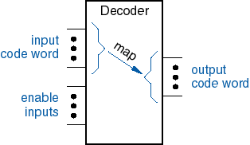
Decoders
Converts input code words into output code words.
One-to-One mapping: Each input code produces only one output code.
Binary Code Gray Code BCD Code Any Code…
Typically n inputs, 2^{n} outputs: 2-to-4, 3-to-8, 4-to-16, etc.

Slide 162
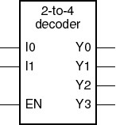
Binary 2-to-4 decoder
n-to-2^{n} decoder: n inputs and 2^{n} outputs.
Example: 2-to-4 decoder
Inputs |  |  |  | Outputs
EN | I1 | I0 |  | Y3 | Y2 | Y1 | Y0
0 | X | X |  | 0 | 0 | 0 | 0
1 | 0 | 0 |  | 0 | 0 | 0 | 1
1 | 0 | 1 |  | 0 | 0 | 1 | 0
1 | 1 | 0 |  | 0 | 1 | 0 | 0
1 | 1 | 1 |  | 1 | 0 | 0 | 0
Binary Code
1-out-of-2^{n}
X: don’t care
One output is asserted for each input code.

Slide 163
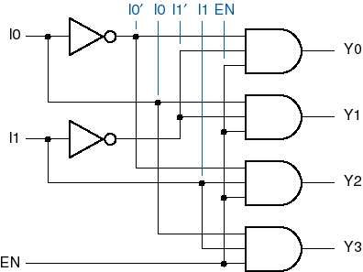
2-to-4- Decoder Logic Diagram

Slide 164
Decoder Applications
Microprocessor memory systems
  selecting different banks of memory
Microprocessor input/output systems
  selecting different devices
Microprocessor instruction decoding
  enabling different functional units
Memory chips
  enabling different rows of memory depending on address

Slide 165
Seven-Segment Displays
Displays decimal numbers and some characters
LED (Light Emitting Diode ) or LCD (Liquid Crystal Display)
a
f
b
g
CommonAnode(CA)
CommonCathode(CC)
a
a
e
c
b
b
c
c
d
d
d
e
e
f
f
g
g
requires Active Low inputs
requires Active High inputs

Slide 166
Seven-Segment Decoders/Drivers
BCD Code
Seven-Segment Code
Input |  |  |  |  | Output
D | C | B | A |  | a | b | c | d | e | f | g
0 | 0 | 0 | 0 |  | 1 | 1 | 1 | 1 | 1 | 1 | 0
0 | 0 | 0 | 1 |  | 0 | 1 | 1 | 0 | 0 | 0 | 0
0 | 0 | 1 | 0 |  | 1 | 1 | 0 | 1 | 1 | 0 | 1
0 | 0 | 1 | 1 |  | 1 | 1 | 1 | 1 | 0 | 0 | 1
0 | 1 | 0 | 0 |  | 0 | 1 | 1 | 0 | 0 | 1 | 1
0 | 1 | 0 | 1 |  | 1 | 0 | 1 | 1 | 0 | 1 | 1
0 | 1 | 1 | 0 |  | 0 | 0 | 1 | 1 | 1 | 1 | 1
0 | 1 | 1 | 1 |  | 1 | 1 | 1 | 0 | 0 | 0 | 0
1 | 0 | 0 | 0 |  | 1 | 1 | 1 | 1 | 1 | 1 | 1
1 | 0 | 0 | 1 |  | 1 | 1 | 1 | 0 | 0 | 1 | 1
a
f
b
g
e
c
d

Slide 167
Encoders vs. Decoders
Decoder
Encoder
Inverse function of a Decoder.
Outputs are less than inputs.
output code
input code
ENCODER
Converts input code words into output code words.

Slide 168
Binary Encoders
Binary encoder
I0
2^{n}-to-n encoder: 2^{n} inputs and n outputs.
Example: n=3, 8-to-3 encoder
I1
I2
Y0
I3
Y1
1-out-of-2^{n}
Binary Code
I4
Y2
Inputs |  |  |  |  |  |  |  |  | Outputs
I0 | I1 | I2 | I3 | I4 | I5 | I6 | I7 |  | Y0 | Y1 | Y2
1 | 0 | 0 | 0 | 0 | 0 | 0 | 0 |  | 0 | 0 | 0
0 | 1 | 0 | 0 | 0 | 0 | 0 | 0 |  | 0 | 0 | 1
0 | 0 | 1 | 0 | 0 | 0 | 0 | 0 |  | 0 | 1 | 0
0 | 0 | 0 | 1 | 0 | 0 | 0 | 0 |  | 0 | 1 | 1
0 | 0 | 0 | 0 | 1 | 0 | 0 | 0 |  | 1 | 0 | 0
0 | 0 | 0 | 0 | 0 | 1 | 0 | 0 |  | 1 | 0 | 1
0 | 0 | 0 | 0 | 0 | 0 | 1 | 0 |  | 1 | 1 | 0
0 | 0 | 0 | 0 | 0 | 0 | 0 | 1 |  | 1 | 1 | 1
I5
I6
I7
Y2 = I1 + I3 + I5 + I7
Y1 = I2 + I3 + I6 + I7
Y0 = I4 + I5 + I6 + I7

Slide 169
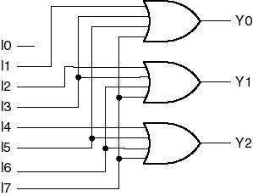
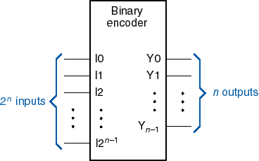
Binary Encoders
Y2 = I1 + I3 + I5 + I7
Y1 = I2 + I3 + I6 + I7
Y0 = I4 + I5 + I6 + I7
Limitations:
Only one input can be activated
Application:
Handling multiple devices requests. But, no simultaneous requests.
Establishing priorities solve the problem of multiple requests.

Slide 170
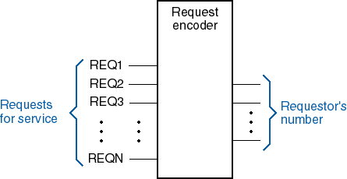
Need Priority in Most Applications

Slide 171
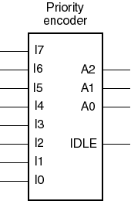
8-Input Priority Encoder
Assign priorities to the inputs
When more than one input are asserted, the output generates the code of the input with the highest priority

Slide 172
Priority-Encoder Logic Equations
(Highest Priority)
H7 = I7
H6 = I6.I7’
H5 = I5.I6’.I7’
H4 = I4.I5’.I6’.I7’
H3 = I3.I4’.I5’.I6’.I7’
H2 = I2.I3’.I4’.I5’.I6’.I7’
H1 = I1. I2’.I3’.I4’.I5’.I6’.I7’
H0 = I0.I1’. I2’.I3’.I4’.I5’.I6’.I7’
IDLE= I0’.I1’.I2’.I3’.I4’.I5’.I6’.I7’
A2 = I1 + I3 + I5 + I7
A1 = I2 + I3 + I6 + I7
A0 = I4 + I5 + I6 + I7
Priority encoder
Priority Circuit
Binary encoder
I0
I0
H0
I0
I1
I1
H1
I1
I2
I2
H2
I2
Y0
A0
I3
I3
H3
I3
Y1
A1
I4
I4
H4
I4
Y2
A2
I5
I5
H5
I5
I6
I6
H6
I6
I7
I7
H7
I7
IDLE
IDLE

Slide 173
Encoder Application (Monitoring Unit)
Controller Response
Alarm Signal
Machine 1
Machine 2
Machine
Code
Action
Encoder
Controller
Machine 3

Slide 174
BCD Encoder
+5V
BCD encoder
Switch 0
74x49
I0
I1
a
I2
Idle
BI
b
I3
c
Y0
A
I4
d
Y1
B
I5
e
Y2
C
I6
f
Y2
D
I7
g
I8
Switch 9
I9

Slide 175
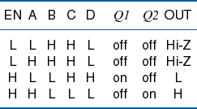

Three-State Buffers
Output = LOW, HIGH, or Hi-Z.
Hi-Z: The output is floating (High Impedance) when the enable input is deasserted →
The input is isolated from the output
Application:
Can tie multiple outputs together, if at most one at a time is driven.
Controlling the access of a single line/bus by multiple devices.

Slide 176
Different Types
Active High Enable
Active Low Enable
Buffers
Active High Enable
Active Low Enable
Inverters

Slide 177
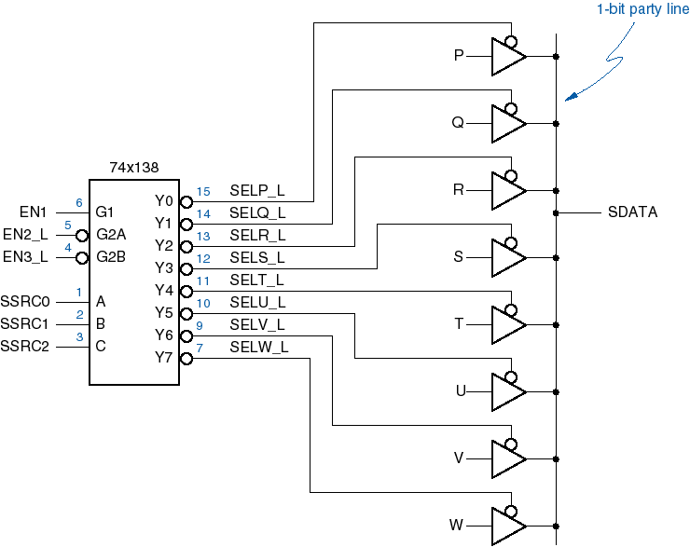
8 Data Sources Sharing One Line

Slide 178
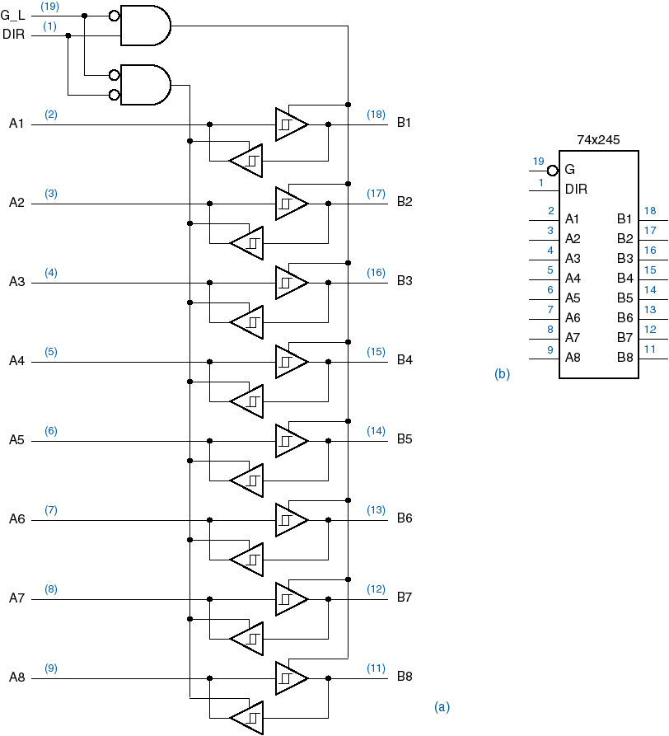
Three-State Transceiver

Slide 179
Multiplexers
Multiplexing: transmitting large number of signals over a small number of channels or lines
Digital multiplexer (MUX): selects one of many input lines and directs it to a single output.
Selection lines controls the selection of a particular input
n selection lines, 2^{n} inputs, single output

Slide 180
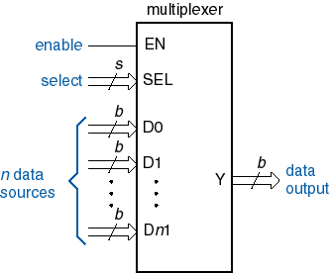
Multiplexers

Slide 181
4-to-1 Line Multiplexer
S1 | SO | Y
0 | 0 | I0
0 | 1 | I1
1 | 0 | I2
1 | 1 | I3
I0
Inputs
I1
4x1
MUX
Output
Y
I2
I3
S1
S0
Select

Slide 182
Logic Diagram of 4-to-1 Multiplexer
I0
I1
Y
I2
I3
S1
S0

Slide 183
Implementing Logic Functions
n- variable logic function can be implemented using 2^{n}-to-1 MUX
The inputs variables are connected to the select input.
The function value for each input combination (0 or 1) is connected to the corresponding input of the MUX
Example: F = Σ_{x,y} (1,3)
Row | X | Y | F
0 | 0 | 0 | 0
1 | 0 | 1 | 1
2 | 1 | 0 | 0
3 | 1 | 1 | 1
0
I0
1
I1
4x1
MUX
F
Y
0
I2
1
I3
S1
S0
X
Y

Slide 184
Example: F = Σx,y,z (2,4,7)
Row | X | Y | Z | F
0 | 0 | 0 | 0 | 0
1 | 0 | 0 | 1 | 0
2 | 0 | 1 | 0 | 1
3 | 0 | 1 | 1 | 0
4 | 1 | 0 | 0 | 1
5 | 1 | 0 | 1 | 0
6 | 1 | 1 | 0 | 0
7 | 1 | 1 | 1 | 1

Slide 185
Functional Decomposition
An effective way for using MUX to implement Logic Functions.
n-row truth table can be implemented using n/2-to-1 MUX:
  Write the Logic function in terms of the least significant input variable.
  The truth table is reduced by one half.
For 3-variable Logic Function, the decomposed truth table is:
Row | X | Y | Z | F
0,1 | 0 | 0 | X | F₀₀(Z)
2,3 | 0 | 1 | X | F₀₁(Z)
4,5 | 1 | 0 | X | F₁₀(Z)
6,7 | 1 | 1 | X | F₁₁(Z)
F₀₀(Z)
I0
F₀₁(Z)
I1
4x1
MUX
F
Y
F₁₀(Z)
I2
F₁₁(Z)
I3
S1
S0
X
Y

Slide 186
Functional Decomposition Example
Truth Table
Decomposed Truth Table
Row | X | Y | Z | F
0 | 0 | 0 | 0 | 0
1 | 0 | 0 | 1 | 0
2 | 0 | 1 | 0 | 1
3 | 0 | 1 | 1 | 0
4 | 1 | 0 | 0 | 1
5 | 1 | 0 | 1 | 0
6 | 1 | 1 | 0 | 0
7 | 1 | 1 | 1 | 1
Row | X | Y | Z | F
0,1 | 0 | 0 | 0 | 0
2,3 | 0 | 1 | X | Z’
4,5 | 1 | 0 | X | Z’
6,7 | 1 | 1 | X | Z
F₀₀(Z) = 0
F₀₁(Z) = Z’
0
I0
F₁₀(Z) = Z’
I1
4x1
MUX
F
Y
I2
Z
F₁₁(Z) = Z
I3
S1
S0
X
Y

Slide 187
Demultiplexers
Demultiplexer (DMUX) performs the opposite function of a MUX.
A digital Demultiplexer receives input data on a single input and transmits it on one of 2^{n} possible outputs according to the value of the n select inputs
MUX/DMUX are used in data transmission
Source
Destination
A
A
B
B
BUS
MUX
DMUX
C
C
Select
Select

Slide 188
1-to-4 DMUX
IN | S1 | S2 | D0 | D1 | D2 | D3
X | 0 | 0 | IN | 0 | 0 | 0
X | 0 | 1 | 0 | IN | 0 | 0
X | 1 | 0 | 0 | 0 | IN | 0
X | 1 | 1 | 0 | 0 | 0 | IN
S0
D0
D1
S1
D2
D0
D3
1x4
DMUX
D1
IN
Input
IN
Outputs
D2
S1
S0
D3
Select

Slide 189
Using Decoders as DMUX
A DMUX has the same structure of a Decoder with enable input.
Decoder can be used as a DMUX by connecting the input data to the enable input.
Example: 2-to-4 Decoder can be used as 1-to-4 DMUX
IN | S1 | S2 | D0 | D1 | D2 | D3
X | 0 | 0 | IN | 0 | 0 | 0
X | 0 | 1 | 0 | IN | 0 | 0
X | 1 | 0 | 0 | 0 | IN | 0
X | 1 | 1 | 0 | 0 | 0 | IN
S0
I0
Y0
D0
S1
I1
Y1
D1
Y2
D2
INPUT
EN
Y3
D3

Slide 190
A Generic Digital Processor
RAM, ROM, Registers, …
MEMORY
CPU
CONTROL
INPUT - OUTPUT
Building Blocks for Digital Architectures
DATAPATH
Finite state machine: PLA, Counters, Flip-flops, Latches, …
Interconnect:
Switches, Arbiters, Bus, …
Arithmetic Unit:
Adder, Multiplier, Shifter, Comparator, …

Slide 191
Comparators
Compares Two binary words and indicate if they are equal
Comparator
A
A=B
B
Advanced Comparators:
A
Comparator
A=B
A>B
B
A<B
1-bit Comparator: XOR gate, the Output is 1 if A ≠ B
A
F
B

Slide 192
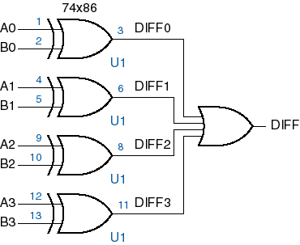

Equality Comparators
1-bit comparator
4-bit comparator
EQ_L

Slide 193
Iterative Comparator
EQI | X | Y | EQO
0 | X | X | 0
1 | 0 | 0 | 1
1 | 0 | 1 | 0
1 | 1 | 0 | 0
1 | 1 | 1 | 1
1 bit comparator:
X
Y
EQO
EQI
Notes:
Two n-bit values X and Y can be compared one bit at a time using a single bit EQi at each step to keep track whether all of the bit-pairs have been equal so far:
Set EQ0 to 1 and set i to 0.
2. If EQi is 1 and Xi and Yi are equal, set EQi+1 to 1. Else set EQi+1 to 0
3. Increment i.
4. If i <n go to step 2

Slide 194
Multibit Iterative Comparator
Iterative Comparator: cascaded 1 bit comparators
X0
Y0
X1
Y1
X(N-1)
Y(N-1)
X
Y
X
Y
EQ1(N-1)
X
Y
EQ0 =1
EQ1
EQ1
EQN
EQI
EQO
EQI
EQO
EQI
EQO

Slide 195
MSI Arithmetic Logic Units (ALU )
ALU performs Arithmetic and Logical Functions
A, B: 4 bit inputs
S3, S2, S1, S0: Function select
M = 0: Arithmetic operations: + = Plus, – = Minus
M = 1: Logical operations: + = OR, . = AND
Inputs |  |  |  | Functions
S3 | S2 | S1 | S0 | M=0 (arithmetic) | M=1 (logic)
0 | 0 | 0 | 0 | A – 1 + CIN | A’
0 | 1 | 1 | 0 | A – B – 1 + CIN | A XOR B’
1 | 0 | 0 | 1 | A + B + CIN | A XOR B
1 | 0 | 1 | 1 | (A OR B) + CIN | A + B
1 | 1 | 0 | 0 | A + A + CIN | 0000
1 | 1 | 1 | 1 | A + CIN | A

Slide 196
Assignments
Implement 16:1 Mux using 4:1 Muxes
Implement using only 2:1 Muxes
  F(A,B,C,D) = (1,2,4,5,7,8,10,11,13,14)
Implement 5:1 Mux using one 4:1 and one 2:1 mux
Notes:
For a 5-to-1 mux you must have (at least) 3 select inputs since 2 select inputs can only select from 4 data inputs. But with 3 select inputs there are 8 patterns, which is why you usually have a 8-to-1 mux. But not every select pattern needs to have a unique choice. Consider a setup where select inputs 000-011 select data inputs A1-A4 and 100-111 always selects data input A5.
You can build such a 5-to-1 mux easily in two ways:
1) Take a 4-to-1 mux, connect A1-A4 and S0-S1 to it. Take the output of the 4-to-1 mux and connect it to one input of a 2-to-1 mux. Connect A5 and S2 to the remaining pins. Now you have a 5-to-1 mux.
2) Take a 8-to-1 mux and connect the A5 input to A6-A8 too.
Both ways can be optimized to use fewer gates if you aren't using premade ICs. Or you can design a 5-to-1 mux from scratch. Write out the truth table, solve the Karnaugh diagrams and optimize the logic function and so on.

